Slide 1
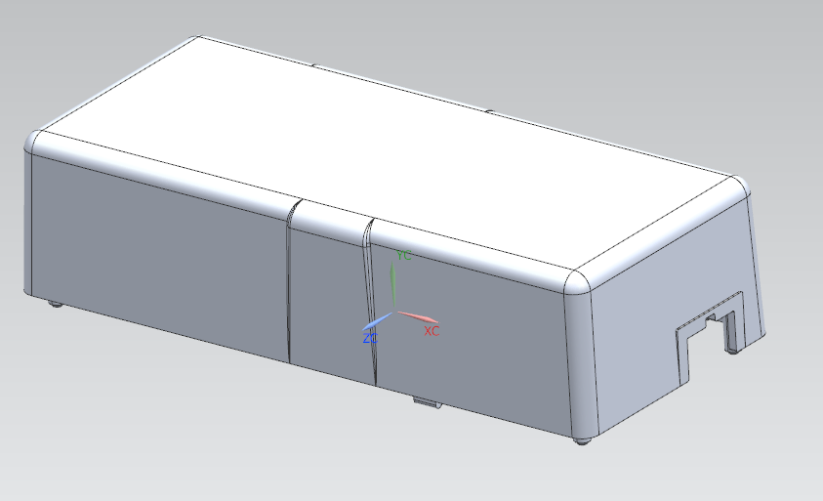
项目名称:
产品尺寸Produce Size: 185X81X53mm

Slide 2
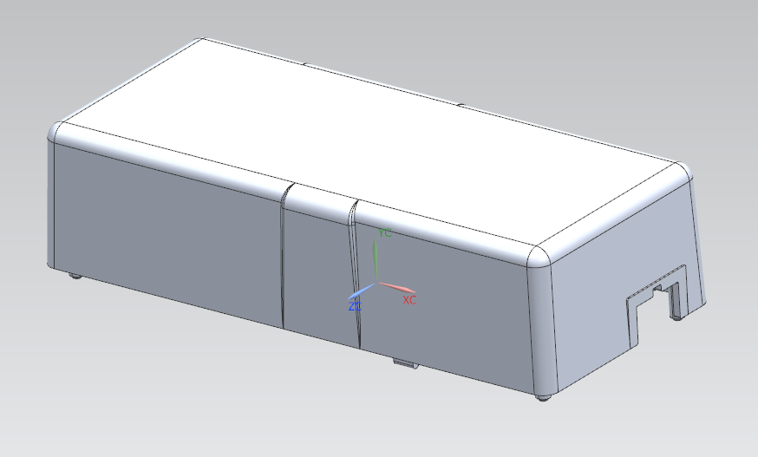
产品/模具分析：Product/Mould Structure Analysis
模具编号： No:
日期 Date:
客户产品编号：Product No:
Product Name:
Cavity:1*1
Mould Type: Injection Mould
Part Material：pp
Machine Type:160t
Shrinkage: 1.015
Runner Type: hot Runner
Cavity Material: 718h
Surface: texture
Surface Treatment :
Core Material: 718h
Slider Material: 718h
Actual Clamping :
Mould Base Material:1.1730
Mould Structure : 2 Plate

Slide 3
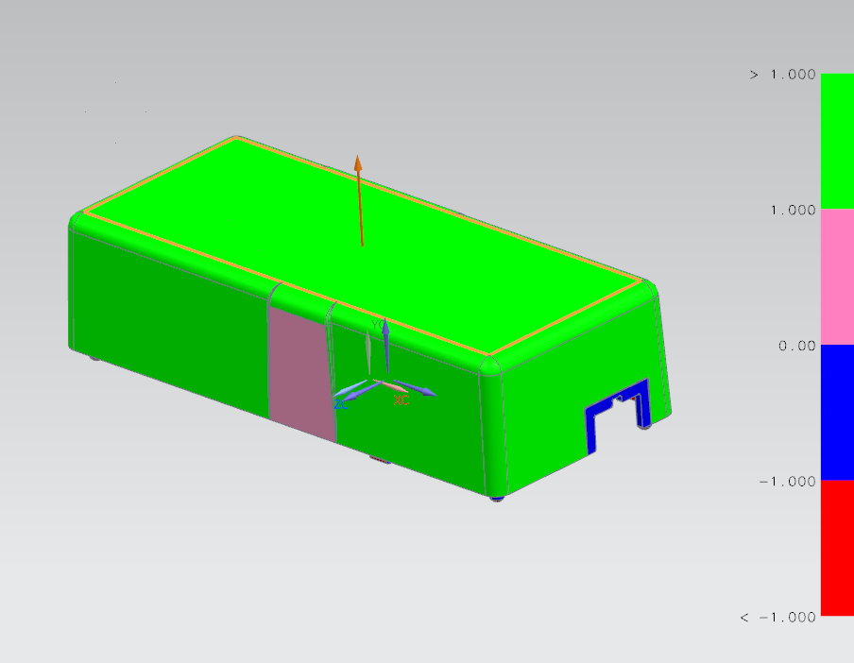
拔模分析:
Demoulding Analysis
The blue surface has no inclination and needs to be modified

Slide 4
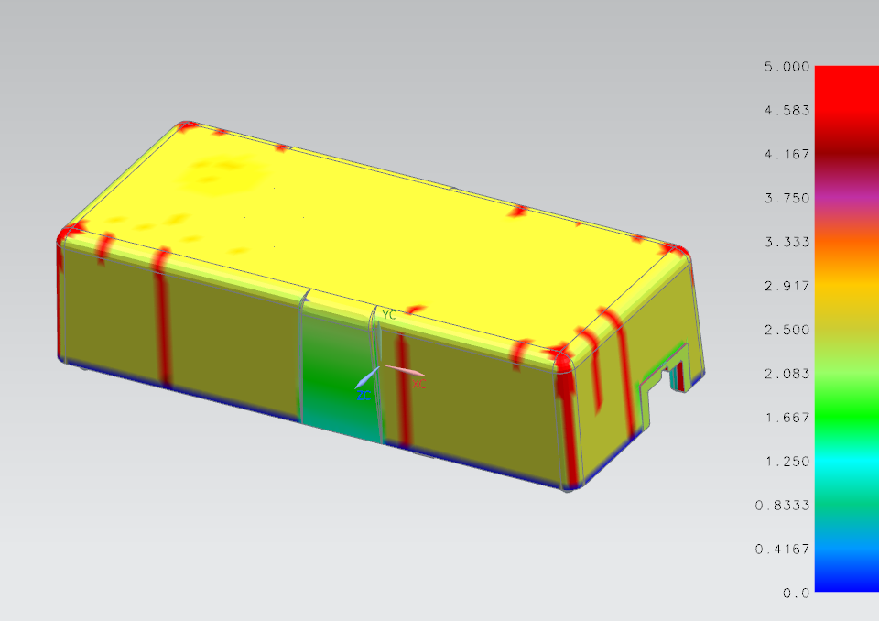
壁厚分析:
Part Thickness Analysis
The red surface is thicker, and there will have sink marks

Slide 5
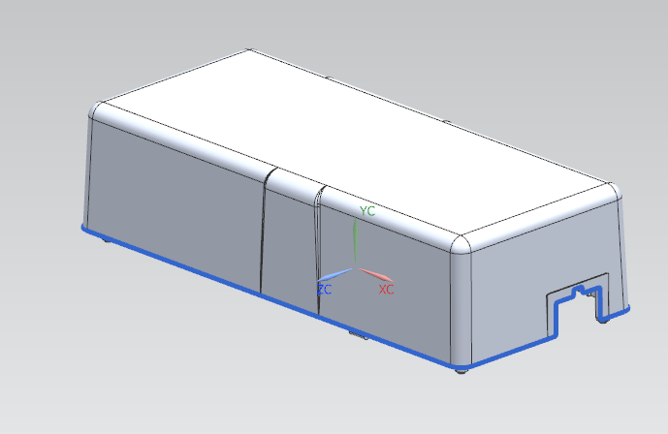
分型线:
Part Line
型腔
Cavity side
型芯
Core side
The bule line is part line, the arrow is demoulding direction

Slide 6
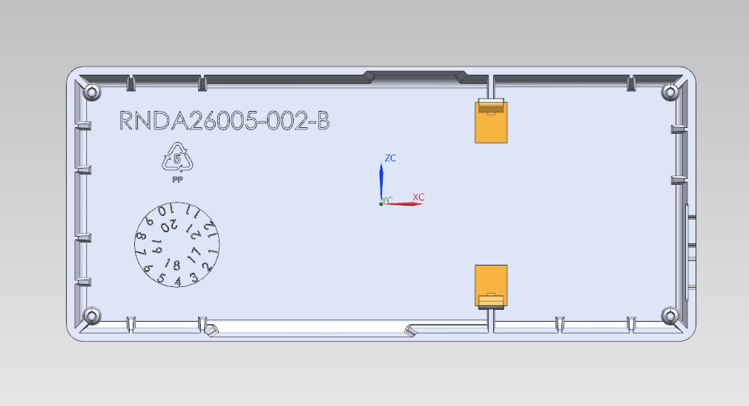
模具结构：
Mould Structure
2lifter

Slide 7
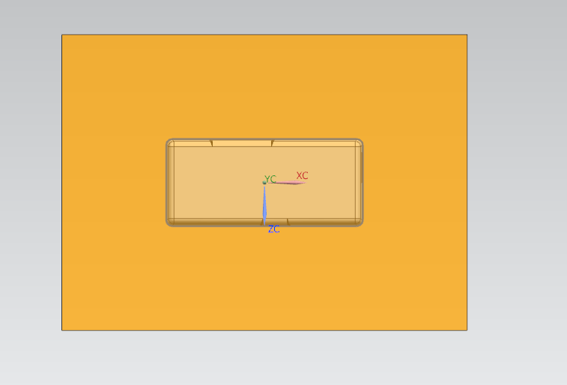
模具尺寸：
Mould Size
Mould Size: 380X280X480mm

Slide 8
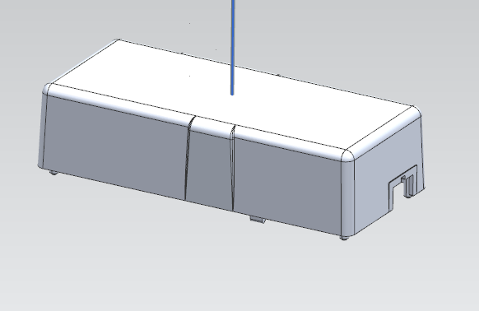
浇口位置：
Gate Position
浇口类型gate：一点热流道，点浇口 1 point gate hot runner

Slide 9
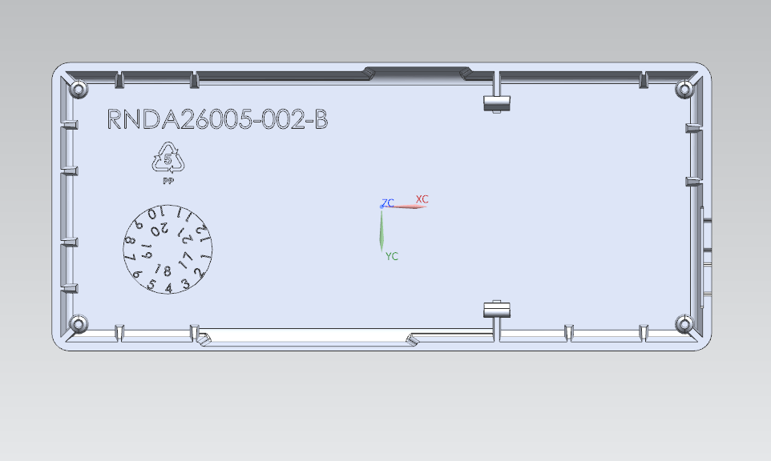
顶针位置和冷却水路：
Ejector Position on Core and Cooling System

Slide 10
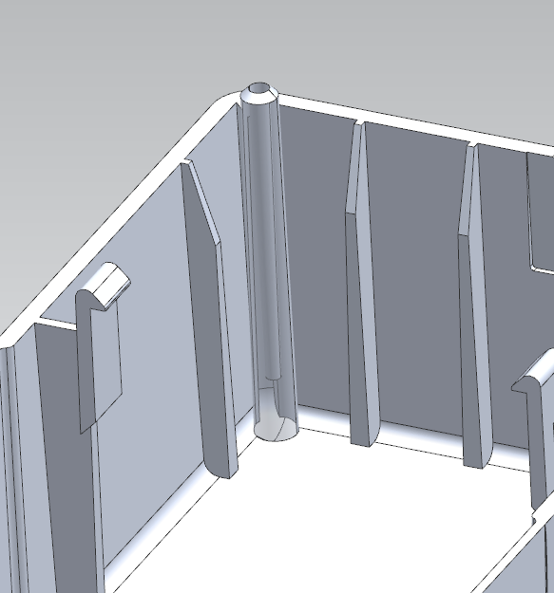
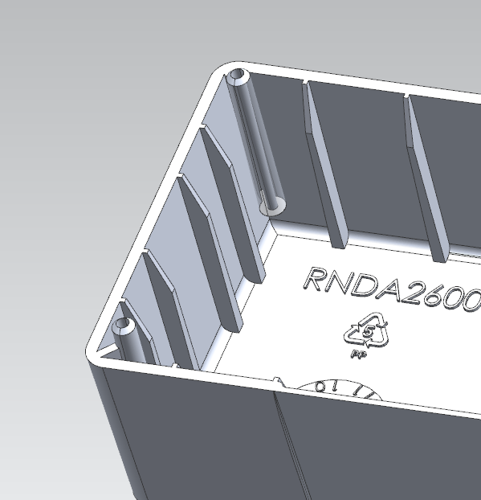
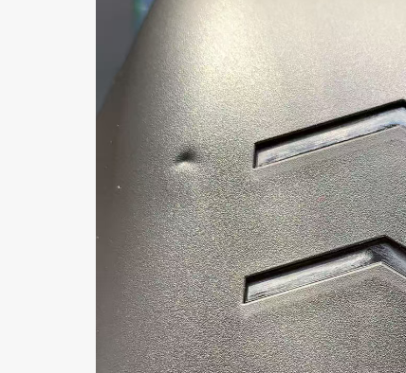
Before modification
After modification
Boss posts need to be modified; otherwise, sink marks will easily occur.

Slide 11
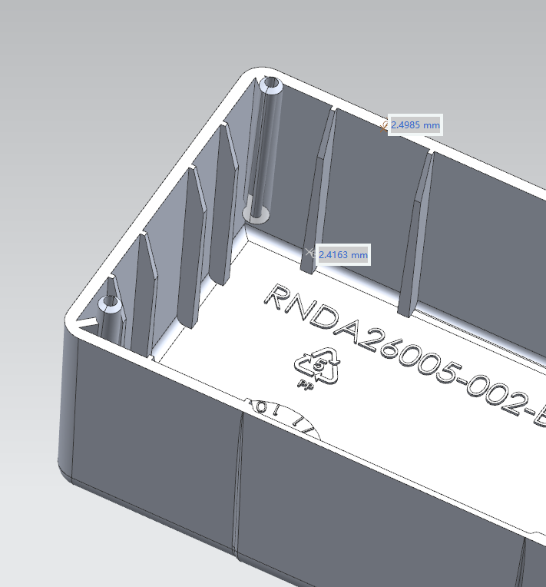
Ribs are too thick and prone to sink marks. Suggest thickness down to around 1mm.

Slide 12
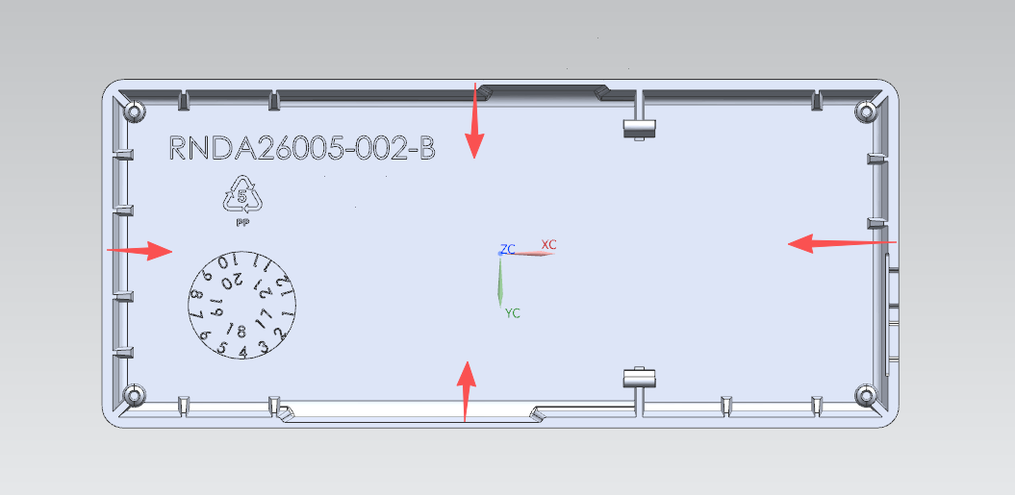
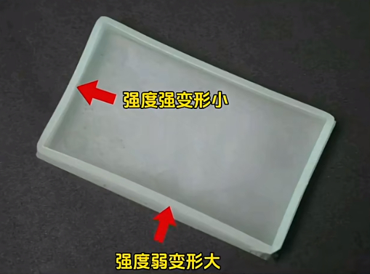
Strong rigidity, little distortion.
Weak strength, heavy distortion.
PP deforms easily and cannot meet tolerances. Recommend ABS plus extra positioning for assembled parts.

Slide 13
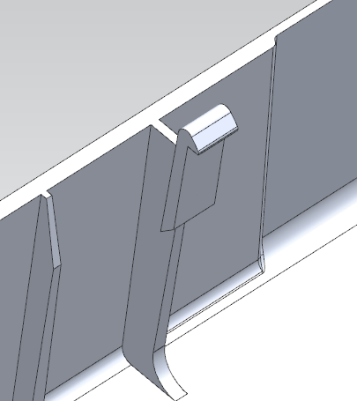
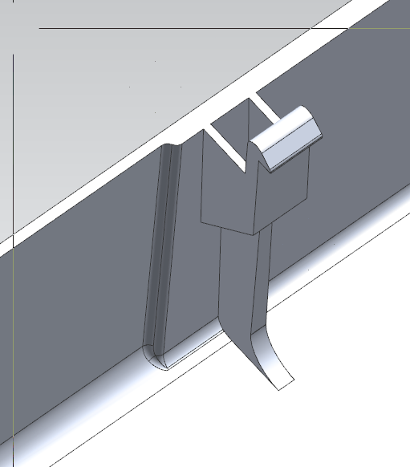
Before modification
After modification
Clips are not strong enough, please revise.

Slide 14
Thank you!
END

